Slide 1
Comparing annual members vs casual riders bike usage
Tsun Hei Tai / September 21

Slide 2
Executive Summary
Average ride duration for casual riders far exceeds the average ride duration of annual members on any given day of the week
Average ride duration for casual riders peaks on a Tuesday
Average ride duration for annual members is more on a weekend than a weekday
Total number of rides for annual members exceeds the total number of rider of casual riders on any given day of the week
The most popular days for casual riders are on Saturdays and Sundays.
For annual members, the most popular days are Monday to Friday.

Slide 3
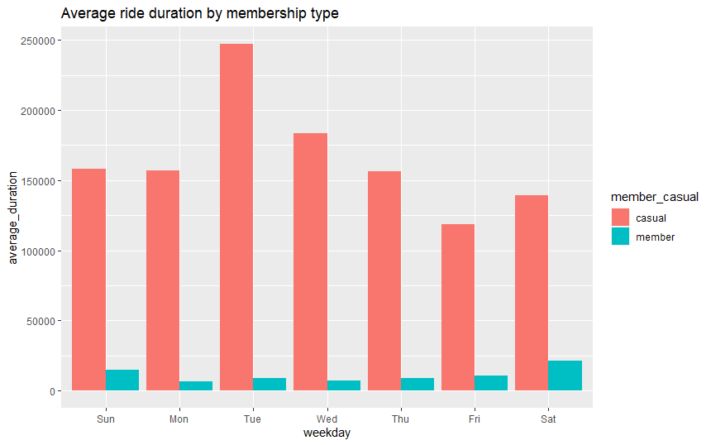
Average ride duration by membership type

Slide 4
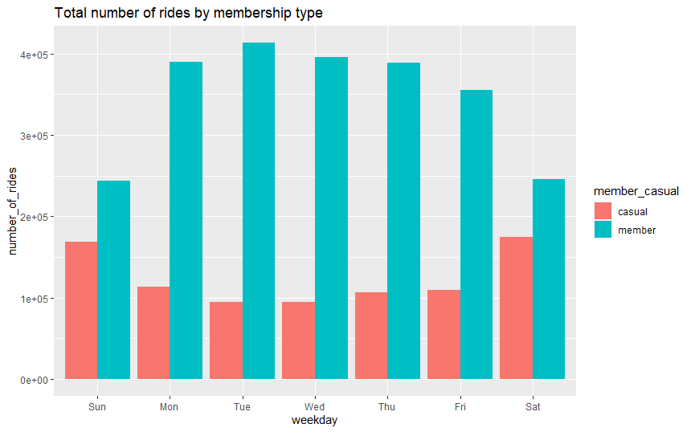
Total number of rides by membership type

Slide 5
Recommendations
1. Most casual riders ride on the weekends, whereas annual members ride most during the weekdays. Recommend a signing on discount for casual riders to become annual members.
2. Casual riders have a far greater average ride duration than annual members. Compare the cost of casual rider trips vs the benefits/cost of becoming an annual member.
3. Further analysis with additional data could help understand why the average ride duration for casual riders is the most on a Tuesday. This may help with converting more casual riders into becoming annual members.

